Slide 1
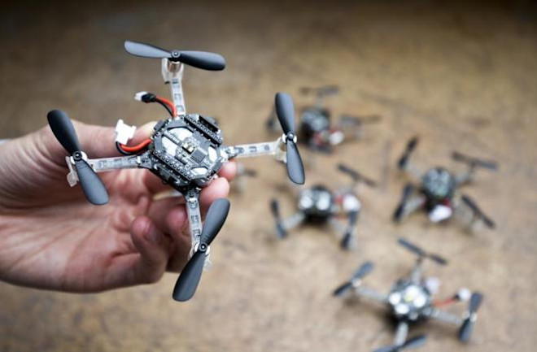
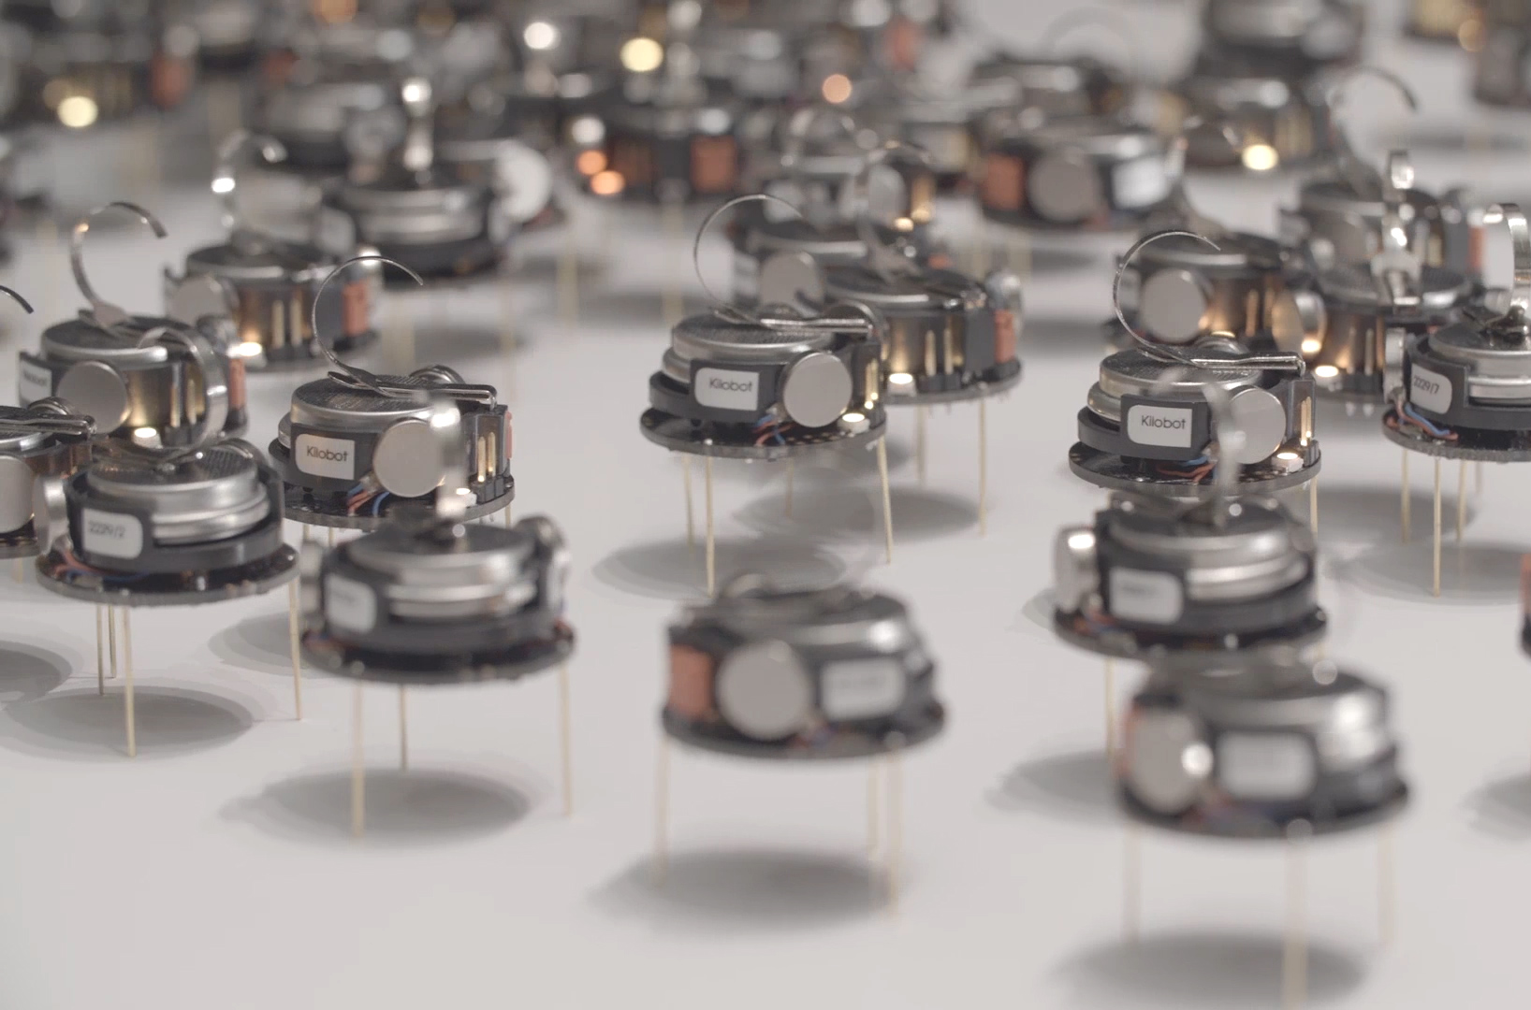
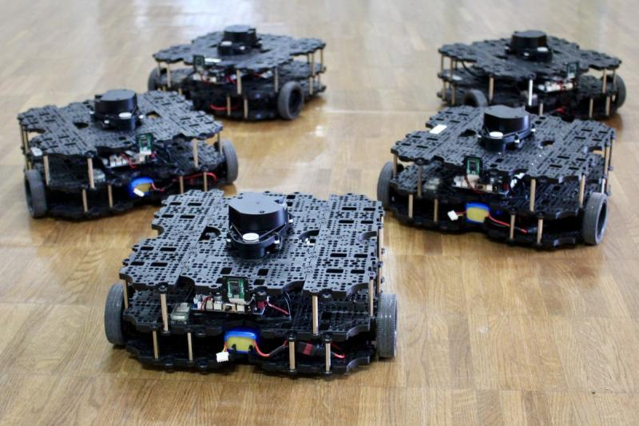

ECE693H, Spring 2025: Multi-robot System Design
“Perception 2”
Dr. Daniel Drew

Slide 2
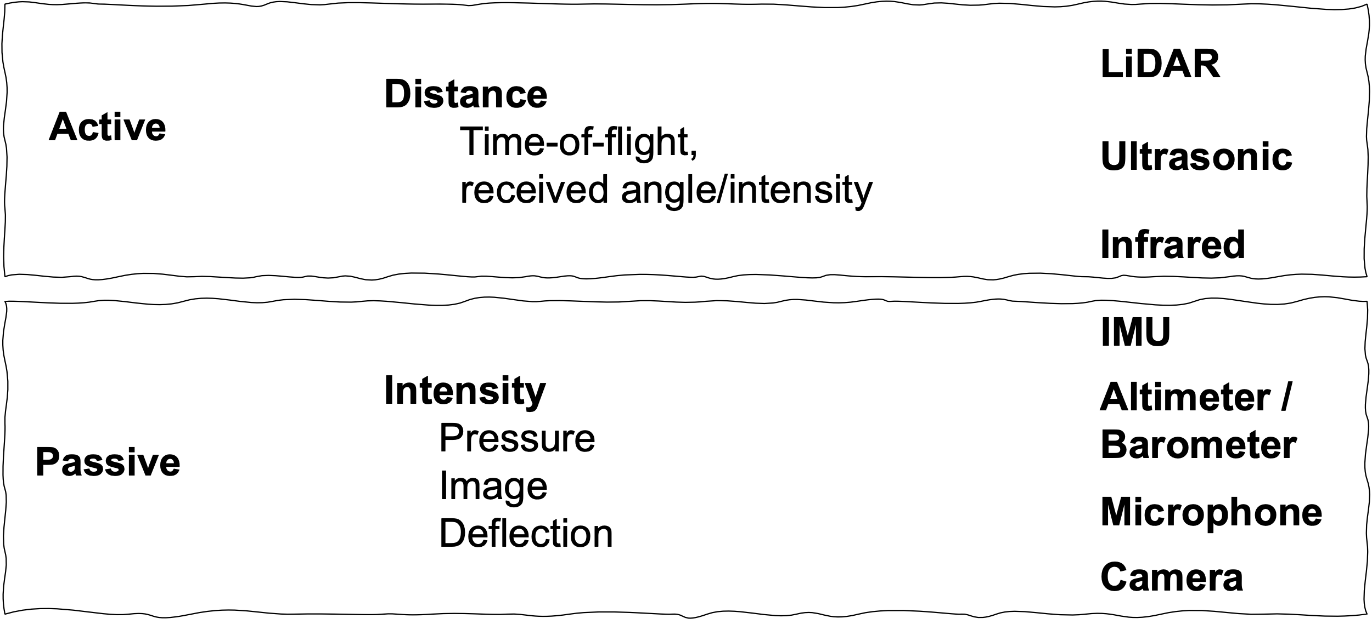
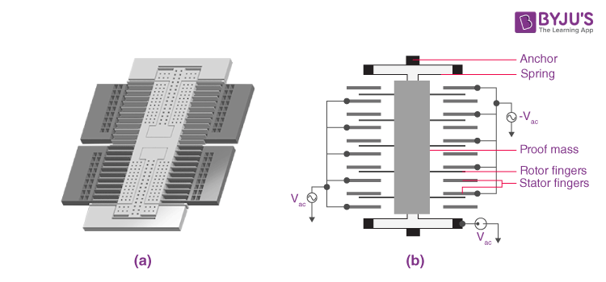
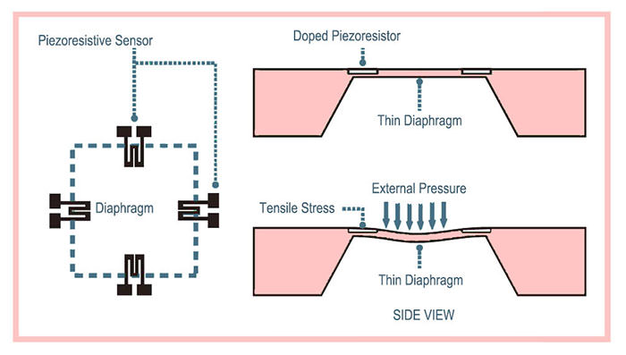
Perception 1 Recap
Overview / Taxonomy
Sensor physics
Data acquisition

Slide 3
Questions?

Slide 4
Class Overview
Lecture (~30 minutes)
Subsystem check-in (~30 minutes)

Slide 5
Perception: Lecture 2 of 2
Lecture 1: sensors → data acquisition
Lecture 2: digital signal processing

Slide 6
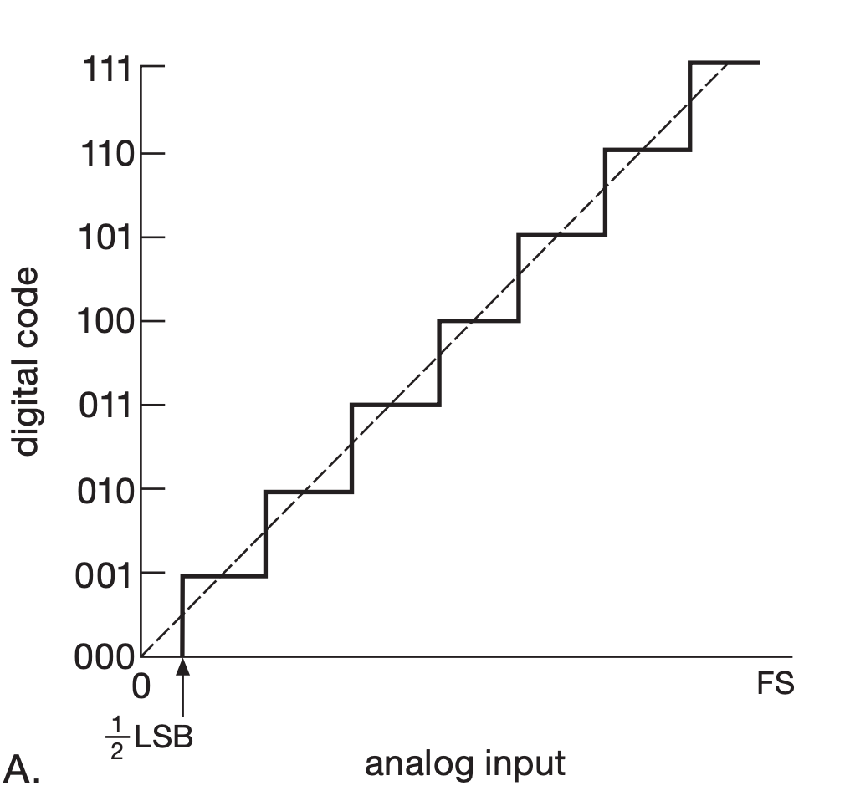
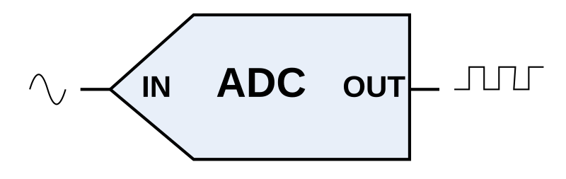
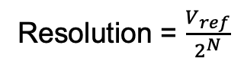
Analog-to-Digital Conversion
“3-bit” ADC:
000 to 111 in binary
0 to 7 in decimal
Resolution = $\frac{V_{ref}}{2^{N}}$

Slide 7
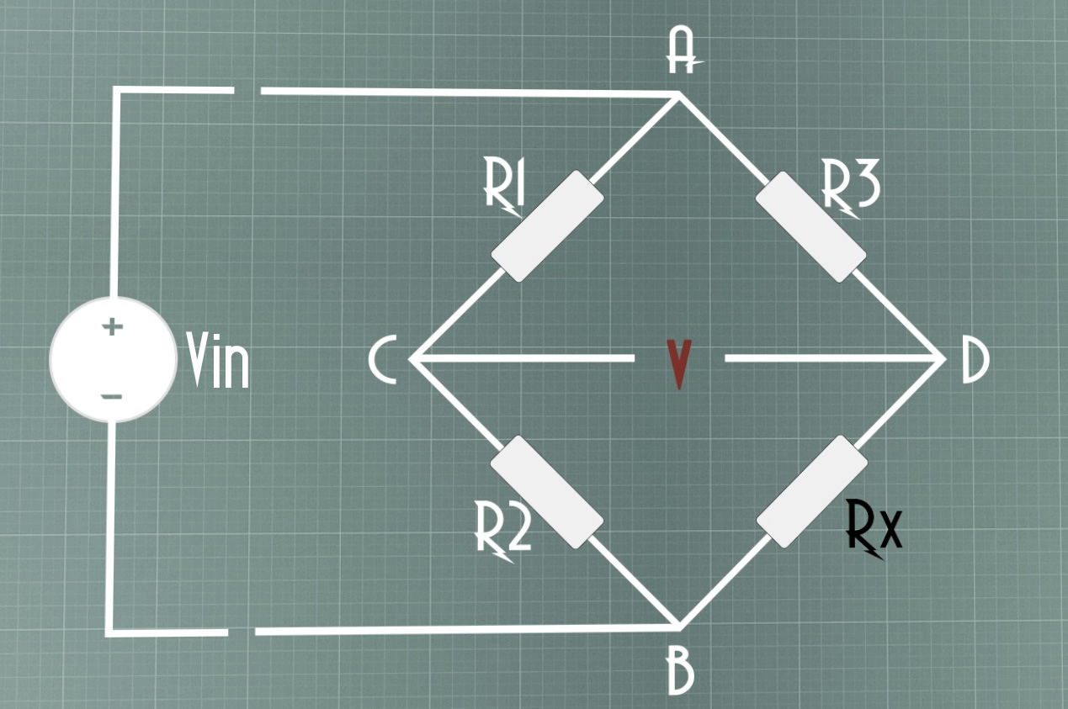
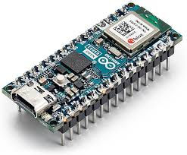
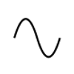
Sensor Scale Factors
F
V
bits
F
(transducer + readout)
(microprocessor)
How do we know what to do?
Datasheets + Calibration

Slide 8
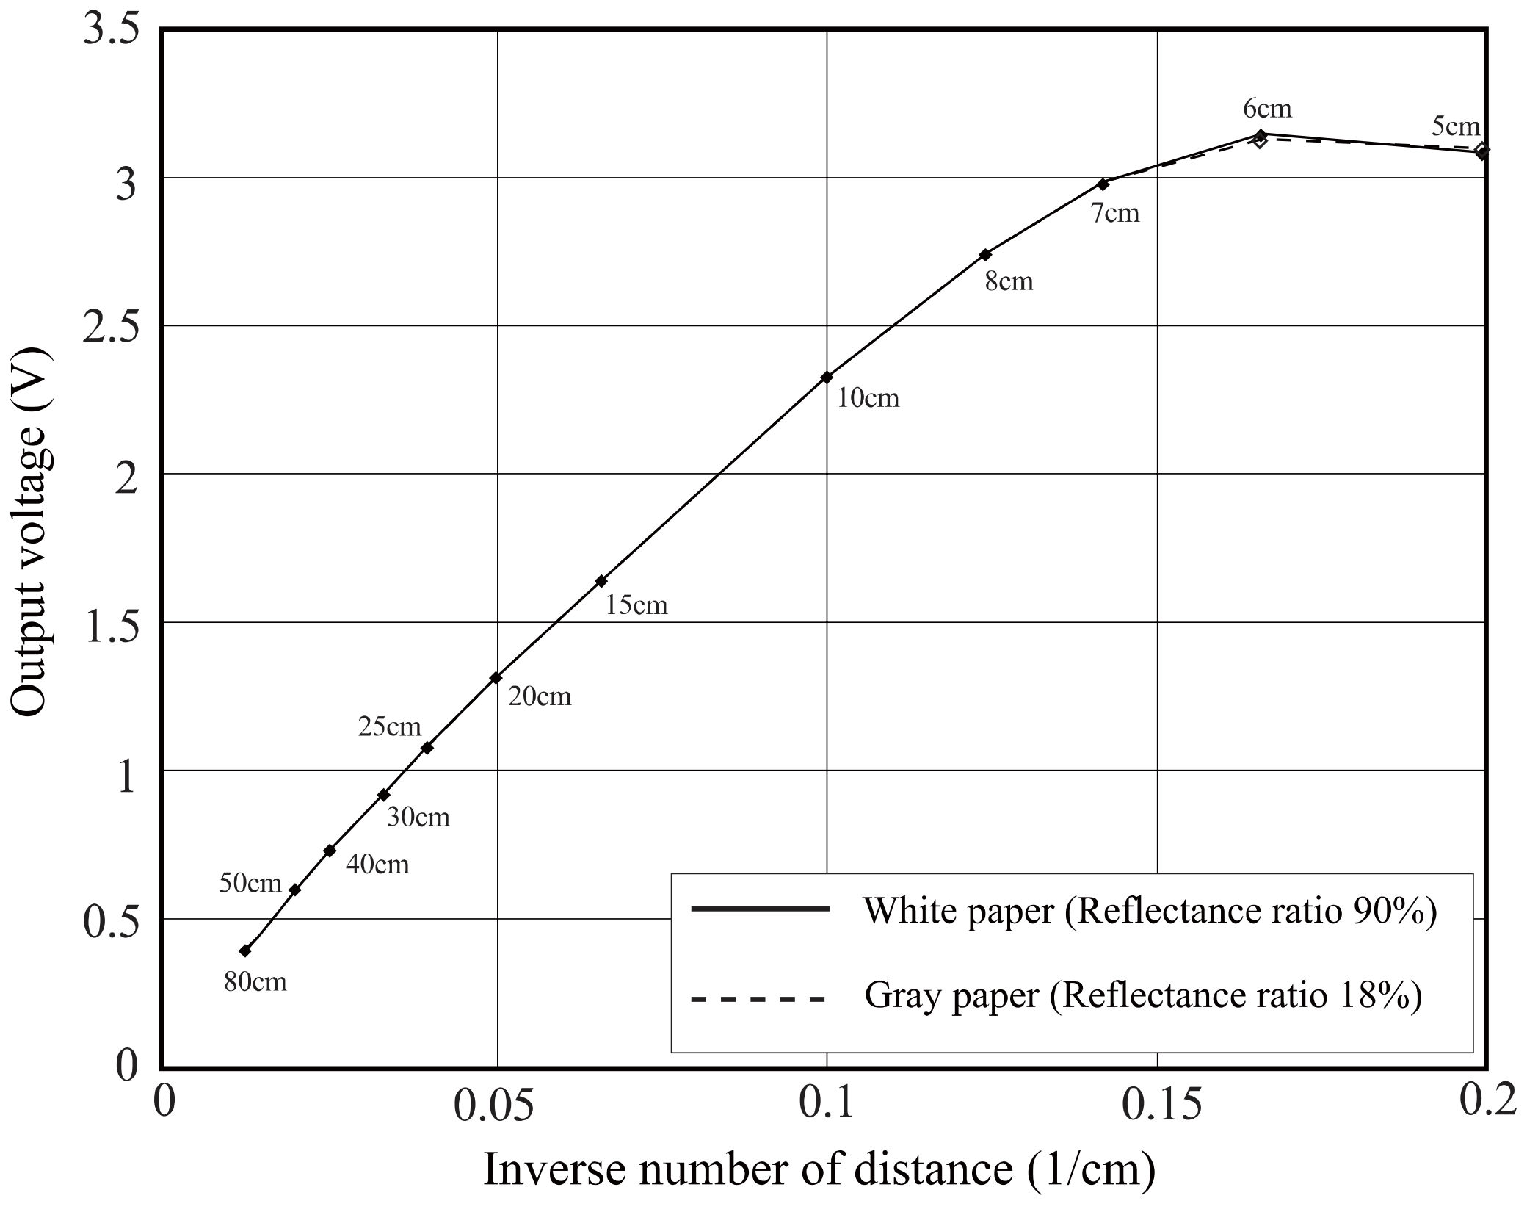
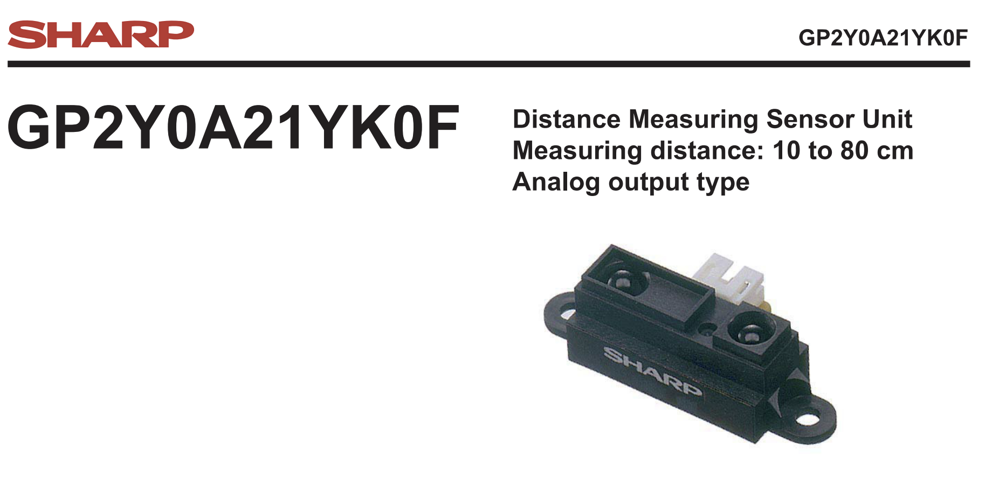
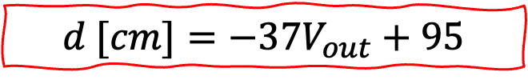
Sensor Scale Factors
F
V
bits
F
(transducer + readout)
(microprocessor)
$$d [cm]=−37V_{out}+95$$

Slide 9
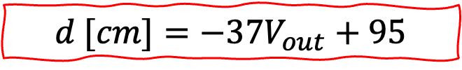
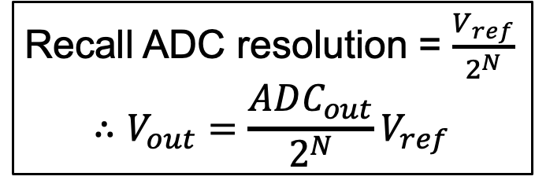
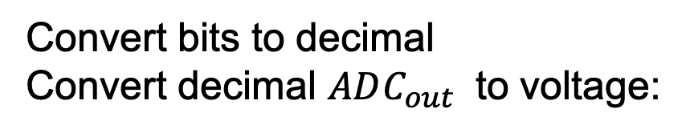
Sensor Scale Factors
F
V
bits
F
(transducer + readout)
(microprocessor)
Convert bits to decimal
Convert decimal $ADC_{out}$ to voltage:
$$d [cm]=−37V_{out}+95$$
Recall ADC resolution = $\frac{V_{ref}}{2^{N}}$
$$∴V_{out}=\frac{ADC_{out}}{2^{N}}V_{ref}$$

Slide 10
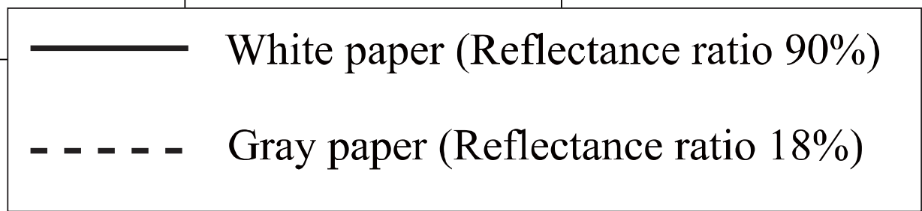
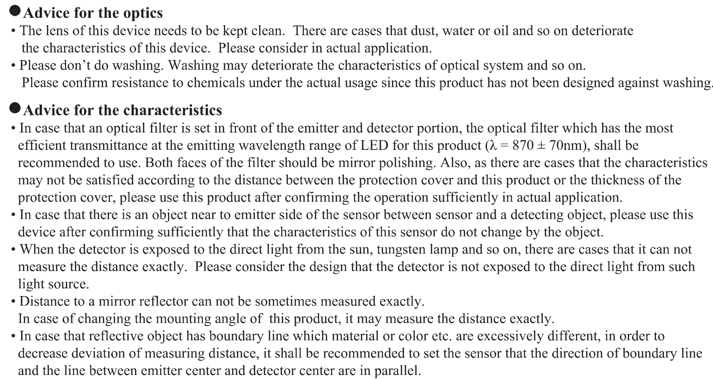
Noise and Error
Essentially, there are lots of reasons your readings may not match the datasheet values; this is true for most sensors.

Slide 11
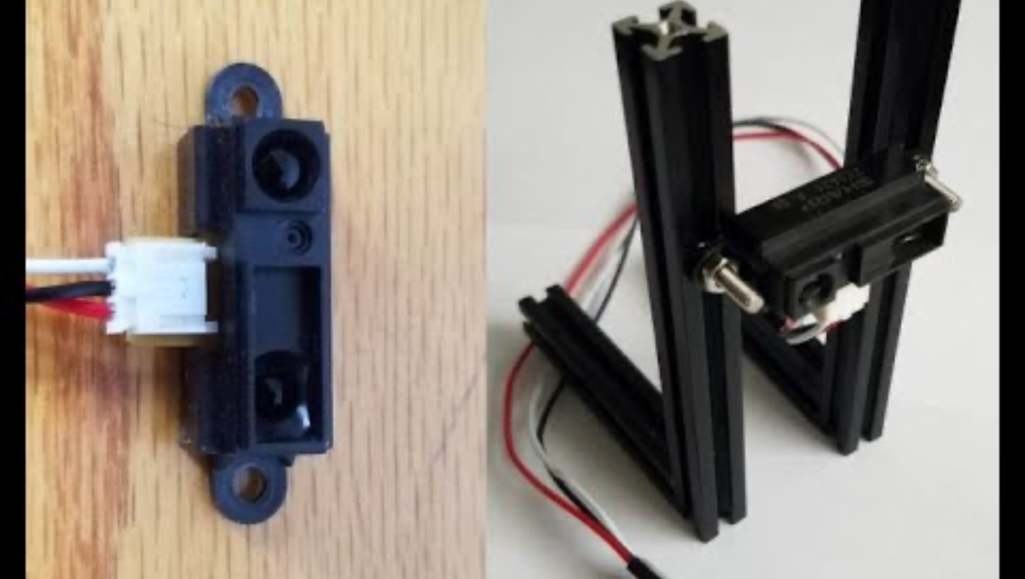
Calibration

Slide 12
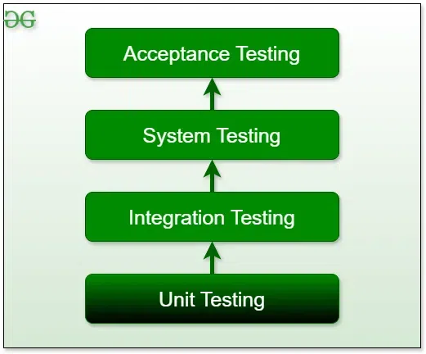
Calibration and Testing
Experimental calibration is recommended for every component, especially because it also functions as a way to perform unit tests.
Can I turn my motor at different speeds?
Can I read from my encoders while turning the motor shaft?
Can I estimate the motor RPM from the encoder counts, as I increase motor PWM?
Can I turn my robot 90 degrees by turning both wheels a set distance?
Is my mechanism to program in turn angles usable by the planning team / end users?
UNIT
INT.
SYS.
(software engineering paradigm)
ACC.

Slide 13
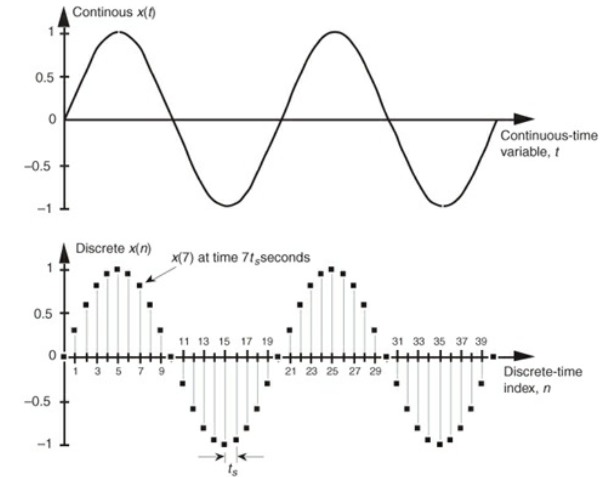
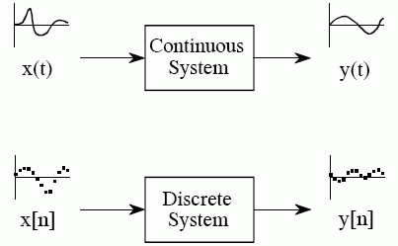
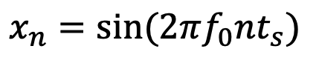
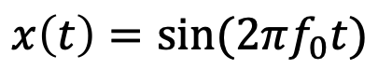
Basic Digital Signal Processing: Signals and Systems
SIGNALS
SYSTEMS
$$x\left(t\right)=sin⁡(2πf_{0}t)$$
$$x_{n}=sin⁡(2πf_{0}nt_{s})$$

Slide 14
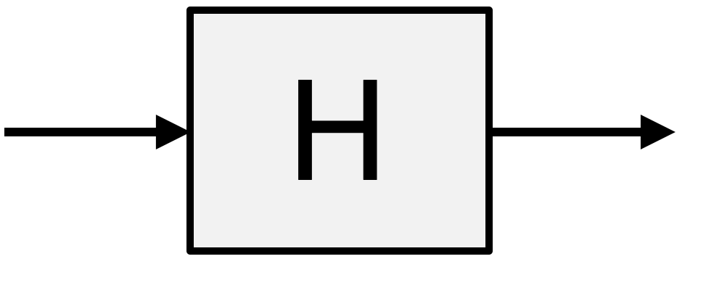
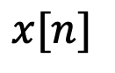
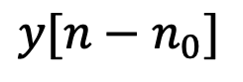
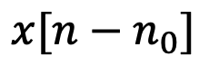
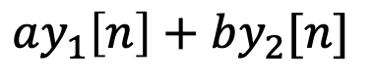
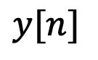
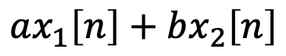
Basic Digital Signal Processing: LTI Systems
$$ax_{1}\left[n\right]+bx_{2}\left[n\right]$$
$$ay_{1}\left[n\right]+by_{2}[n]$$
Linearity
(additivity + homogeneity)
$$x[n]$$
$$y[n]$$
$$x[n−n_{0}]$$
$$y[n−n_{0}]$$
Time invariance
Linear Time-Invariant (LTI) systems are typically what we design for and control;
Nonlinear control is hard, sometimes it’s just as effective to linearize / assume linear!
Notes:
Time invariance: e.g., y(t) = t x(t) is NOT, y(t) = 8x(t) IS

Slide 15
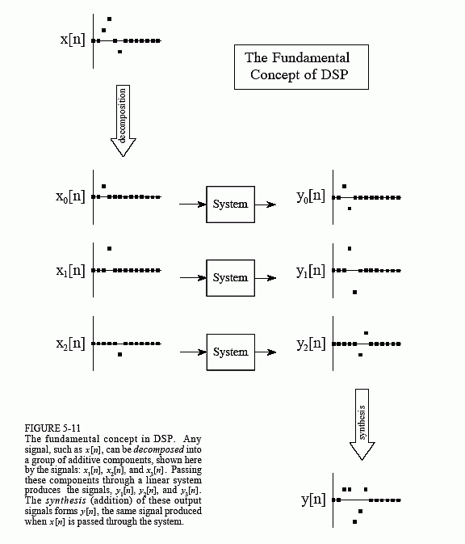
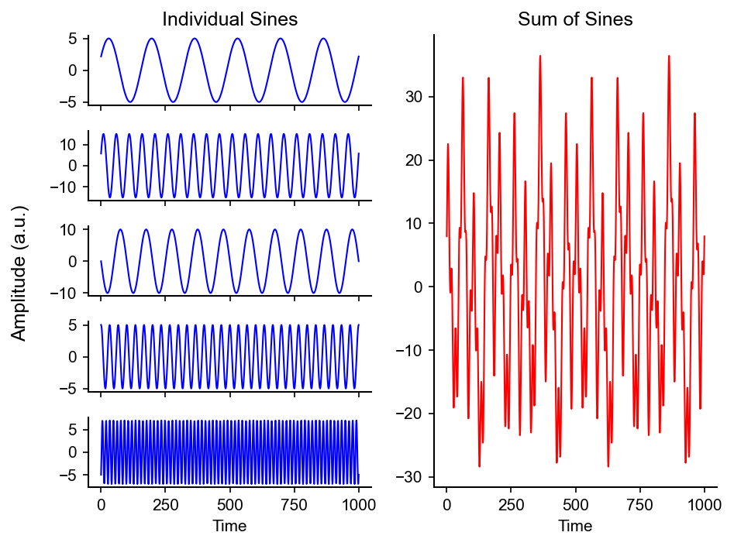
Decomposition and Synthesis

Slide 16
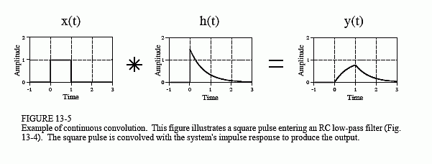
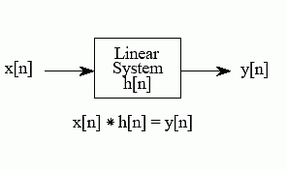
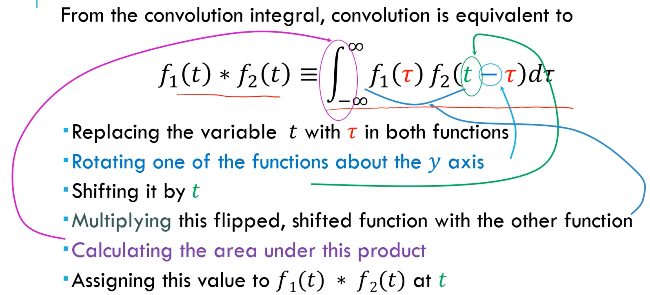
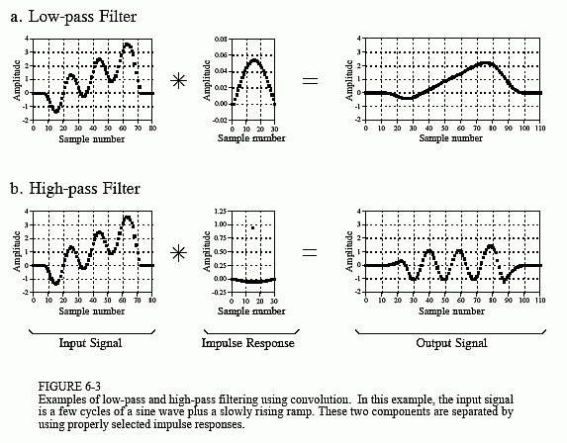
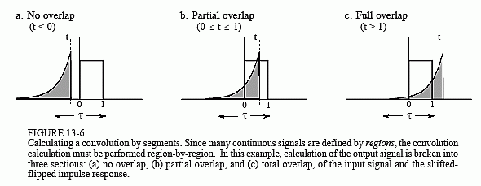
Convolution

Slide 17
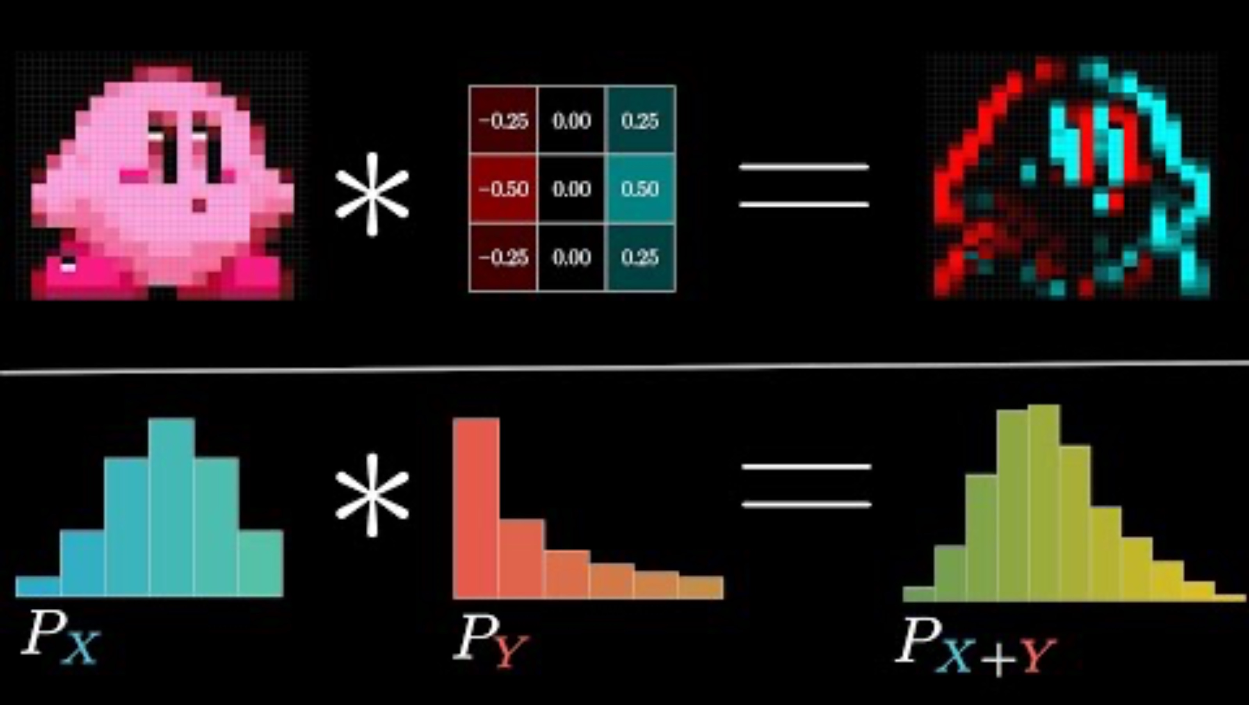
Convolution

Slide 18
Convolution
In robotics:
-Image processing (edge detection, CNNs)
-Spatial filtering (LiDAR point cloud processing)
-Odometry (motion model convolved with odometry uncertainty probability distribution)

Slide 19
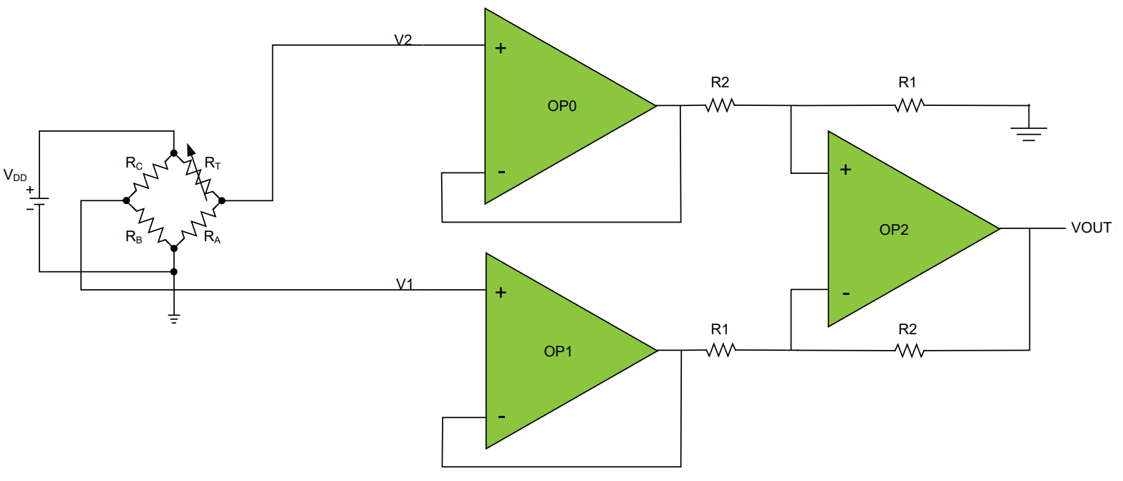
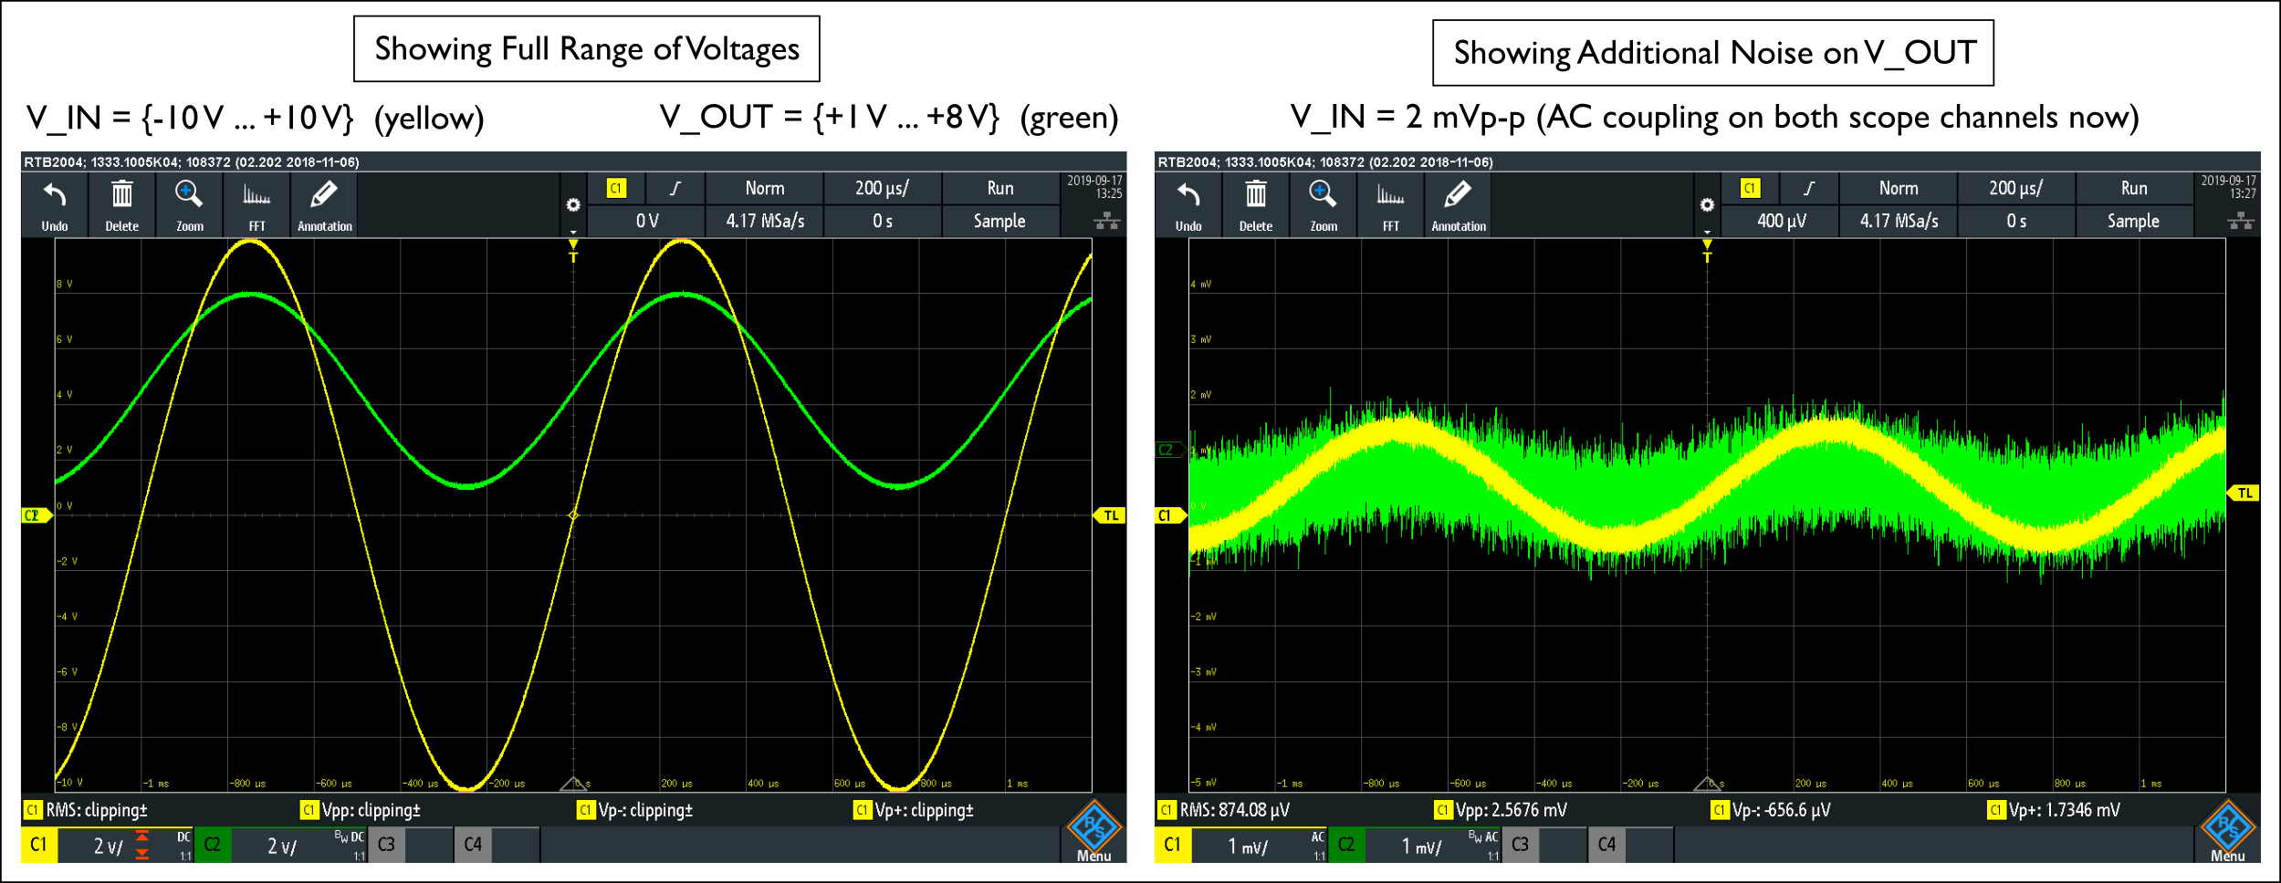
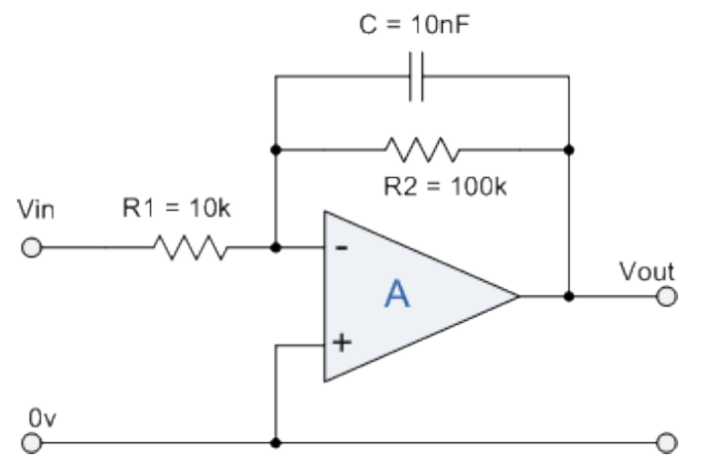
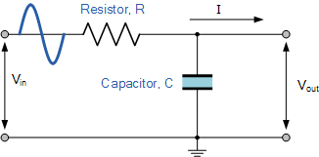
Signal Conditioning: Passive / Active Filters
Passive filter
Active filter
Notes:
https://www.egr.msu.edu/classes/ece445/mason/Files/Lab_8.pdf

Slide 20
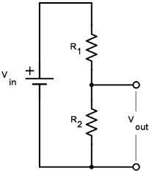
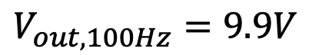
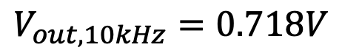
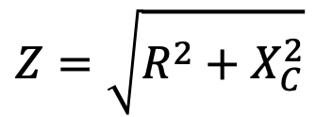
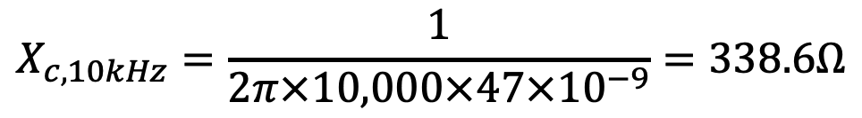




Analog Signal Conditioning: The RC Filter
Recall the voltage divider:
$$V_{out}=V_{in}\frac{R_{2}}{R_{1}+R_{2}}$$
$$X_{C}=\frac{1}{2πfC}$$
$$Z=\sqrt{R^{2}+X_{C}^{2}}$$
capacitive reactance:
impedance of series res. and cap.:
$$X_{c,100Hz}=\frac{1}{2π×100×47×{10}^{−9}}=33,863Ω$$
$$X_{c,10kHz}=\frac{1}{2π×10,000×47×{10}^{−9}}=338.6Ω$$
$$V_{out}=V_{in}\frac{X_{C}}{Z}=V_{in}\frac{X_{C}}{\sqrt{R^{2}+X_{C}^{2}}}$$
$$V_{out,100Hz}=9.9V$$
$$V_{out,10kHz}=0.718V$$
(10V input, 47nF cap, 4.7k resistor)

Slide 21




Analog Signal Conditioning: Multistage Filters
$$f_{c}=\frac{1}{2πRC}$$
cutoff frequency

Slide 22

Filters at a Glance
(each can be implemented in analog or digital!)

Slide 23


Spectral Analysis: The Frequency Domain
Bird chirping
Can you guess?

Slide 24

Spectral Analysis: The Frequency Domain
Apple Testing

Slide 25

Spectral Analysis: The Fourier Transform

Slide 26

The Fourier Transform

Slide 27

Spectral Analysis: The FFT
The “FFT” is a way of quickly solving the DFT with a computer.
The details of implementation are not necessary to understand*, so long as you understand Fourier analysis at a high level.
*for most applications

Slide 28

Popping out and applying this to robotics
Distance measurements are noisy (e.g., reflections, ambient) and need amplification;
IMU measurements are noisy (e.g., motor vibrations, people walking);
Microphone measurements pick up background noise;
Contact mechanics are temporospatial complicated, and not all useful;
Wireless communication is only reliable AFTER lots of processing

Slide 29

Popping out and applying this to robotics (1 of 2)

Slide 30
Lecture (~30 minutes)
Subsystem check-in (~30 minutes)
Questions?
Questions?
Lecture 1: sensors → data acquisition
Lecture 2: digital signal processing

Slide 31

693H Robotic Subsystems
REMINDERS:
-PARTS ORDER GOING IN TONIGHT
-First Design Review Presentations are 2/10, 2/12
-I will randomly select which two groups present which day. Be ready on 2/10.
-Link to presentation templates are posted on Discord + Laulima

Slide 32

693H Robotic Subsystems
Motors, drive electronics, encoders, PID controllers, top-down tracking
Sensor suite (IMU, prox.), calibration code, general IO (buttons and LEDs)
Mobility
Perception
Compute and Power
Control and Planning
Battery and charging, wireless comms, GPIO and power distribution routing
microROS, ROS2, Gazebo simulation, enclosure design
Mechanics / Prototyping
Coding
PCB Design

